Slide 1
EEMP 2024 – GROUP 1
Angelika Stauch, Patrik Zoltan Peter, Oskar Matthias Lange

Slide 2


Research Question & Hypothesis
“Do improvements in education predict higher economic growth?”
Null-hypothesis:
average years of schooling have no relation to GDP per capita
(log) GDP per capita = a + b*Average years of schooling + … + e
linear regression form
Alternative:
average years of schooling have a relation to GDP per capita
Notes:
one UN SDG target is to improve education access and quality worldwide…
we decided to explore the impact of improvements in education on a countries GDP growth
We used average years of schooling as a proxy for education
and operationalised GDP as (log) GDP per capita

Slide 3
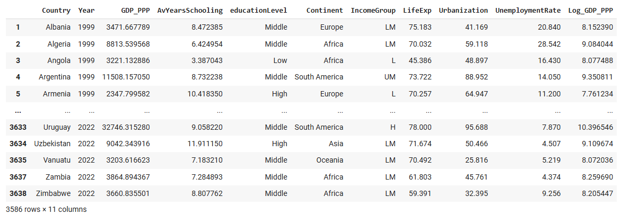
Data Overview
Description | Value
Type of data | Observational; Panel data
Timeframe | 1999 - 2022
Countries | 156
Description | Value
Number of Observations | 3586
Variables | 10
Currency | US$ PPP
Data Sources: raw.githubusercontent.com/AStauch/GroupWork_EEMP_NameResearchQuestion/refs/heads/main/Data/0.Data Sources and Variables.txt
Notes:
we merged different data into this final dataset
Urbanization as a share of the population living in urban areas and unemployment rate as share of total labor force

Slide 4
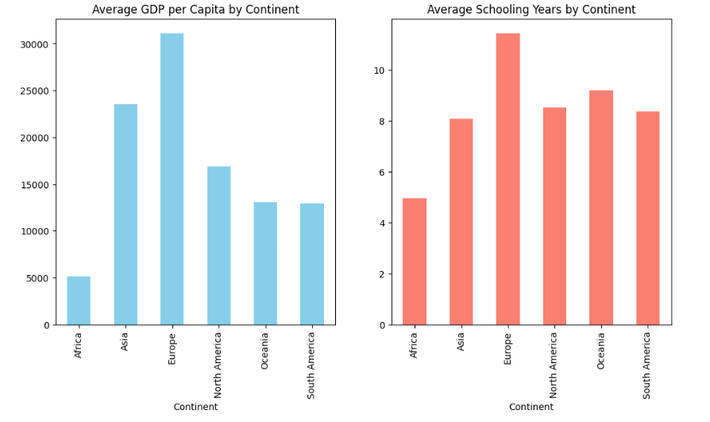
Visualization
Europe leads in both metrics
Africa lags behind
Other continents show balanced trends

Slide 5
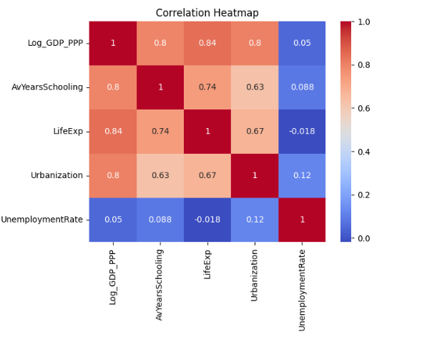
Visualization
Simplifying relationships between variables
Strong positive correlation between schooling, life expectancy, urbanization and GDP
Weak influence of unemployment rate

Slide 6
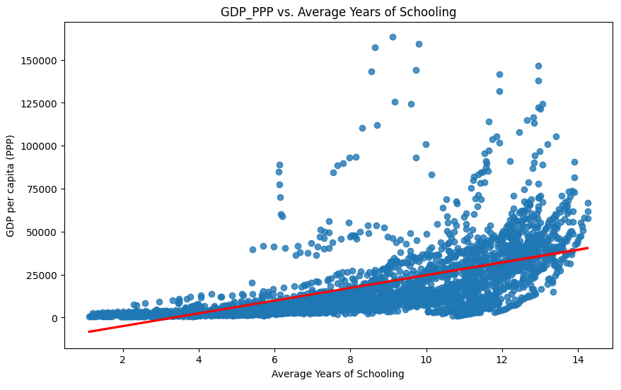
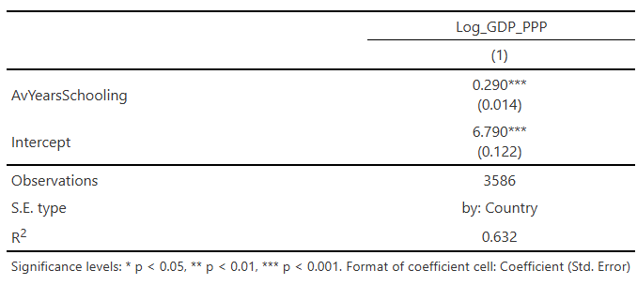
Simple Regression
Coefficient: significant (p<0.001)
Acceptable standard errors: conf. bands between ~ 26%-31,5% (for 5%-significance level)
R²: moderate-high
Specifications:
Log GDP per capita
Robust standard errors clustered on countries
Notes:
With the plot we also see why we impose a log relation on GDP per capita for our analysis…
robust standard errors -> allow for heteroscedacity (not assuming independence in the residuals’ variance) (and not assuming normal distribution)
clustered on country -> accounting for interdependence between country observations
Otherwise we would might have biased (too low) standard errors, as we wouldn’t account for correlation between observations
high t-values (higher then |2| on both sides (for two-sided 5% significance test))
On average, 1 additional year of schooling
-> associated with 29% increase in Log GDP
However, we likely overestimate the relation of AvYearsSchooling on Log_GDP_PPP. It will only have a causal interpretation, if the conditional Independence Assumption holds, i.e., the Average Years of Schooling is the only thing driving GDP. This assumptions is likely not true. So we need to account for control variables to come closer to true effect… only if all omitted variables are captured by AvYearsSchooling we would have no omitted variable bias

Slide 7
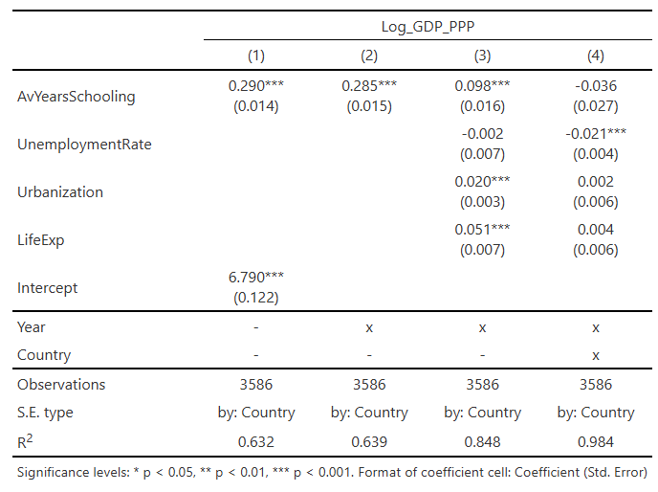
Control Variables
LifeExp AvYearsSchooling
LifeExp Log_GDP_PPP
UrbanizationRate AvYearsSchooling
UrbanizationRate Log_GDP_PPP
UnemploymentRate Log_GDP_PPP
still a positive relation on AvYearsSchooling on Log_GDP_PPP
R² increases substantially
once adding country-level fixed effects, the relation becomes non-significant
R² is now really high!
-> overfit in our model?
Notes:
Continuing using robust standard errors clustered by country and log GDP per capita
Brief explanation on years Fixed effects (new base for further analysis, improves R² a bit without extreme change in standard errors and AvYearsSchooling; reasonable for Panel data..)
Panel Data assumption for fixed effects: parallel time trends! In addition fixed effects only eliminate time-constant omitted variables)
Having panel data over several years allows us to observe effects over time, thereby bringing us closer to the true causal effect
Adding control variables bring us closer to true causal effect. It reduces noise in the error term. Without accounting for them we could overestimate the effect of AvYearsSchooling on Log_GDP_PPP. There is the omitted variable bias.
good controls can also reduce standard errors; bad controls are themselves affected by the dependent variable - they can pick up part of the effect
Control Variable assumptions:
LifeExp -> a confounder; would reduce bias and get the coefficient closer to true effect
UrbanizationRate -> a confounder; would reduce bias and get the coefficient closer to true effect
UnemploymentRate -> a neutral control variable, possibly good for precision; could improve precision and reduce variance
FixedEffects for Country -> we control for country level heterogeneity; we control for all observable country characteristics that are constant over time (such as culture) that could impact the relation
adding control variables (model3), the coefficient of AvYearsSchooling is still significant, but smaller. Standard errors are not too high; the R² increases substantially, implying that our model fits the data better
# urbanization and lifeExp are significant and positive; some of the previously explained association was likely due to them;
adding country fixed effects in Model 4: standard errors are really high -
Model 4 in general issues: no significance, very high R² -> overfitting? Also maybe multicollinearity issue (high R² but no statistical significance.).
Model 4 doesn’t have explanatory power for the AvYearsSchooling coefficient…
it may be that no claim can be made on such high worldwide-level since there are too many differences in countries that drive effect -> looking at subgroups might be better; constant unobserved factors in countries make the results insignificant
Of course this could also be due to measurement error… maybe our variables are not operationalised in a way that we can capture the causal effect… in both models, we would underestimate the causal effect… all used control variables are just proxies for the bigger picture (like economic health)
even on model 3, which is likely better, but we will likely still have omitted variable bias… thereby not capturing the true causal effect -> it’s just a predication and not a causal effect
Transition to next slide: adding country fixed effects, we get inconclusive results ... we decide to analyse on a smaller level -> regions/ continents (testing without country level fixed effects since it makes all results “automatically” insignificant (at least for the share of tested regressions))
Life Expectancy (e.g., proxy for structural differences in public health, living conditions, social development, etc.)(not controlling for it would overestimate effect - imposing bias)
LifeExp -> Average Years of Schooling (children can stay in school longer)
LifeExp -> GDP per capita (healthier and (longer) more productive workforce)
UnemploymentRate (proxy labor market participation and conditions)
UnemploymentRate -> GDP per Capita (higher economic prod.)
Urbanization Rate (proxy for education infrastructure and higher productivity)
UrbanizationRate -> Average Years of Schooling (access to (higher) education available))
UrbanizationRate -> GDP per capita (work access, productivity, …)
[educationGDPspending -> could be used as a proxy for education quality. After consideration decided to be probably a bad control since average years of schooling might influence education GDP spending. And education GDP spending might influences by GDP per capita…. Decided to leave out.]
[IncomeLevels -> could be interesting to check for structural differences across countries (e.g., countries ability to invest in education and economic productivity) but could also lead to model overadjustment if part of school years relation is capture by income group (underestimating school years effect) or it acts as a mediator (more education -> higher income) —> running separate models showed rather high R². We decide to focus on the three control variables in the etable… in further more nuanced analysis this could be interesting to consider again though]

Slide 8
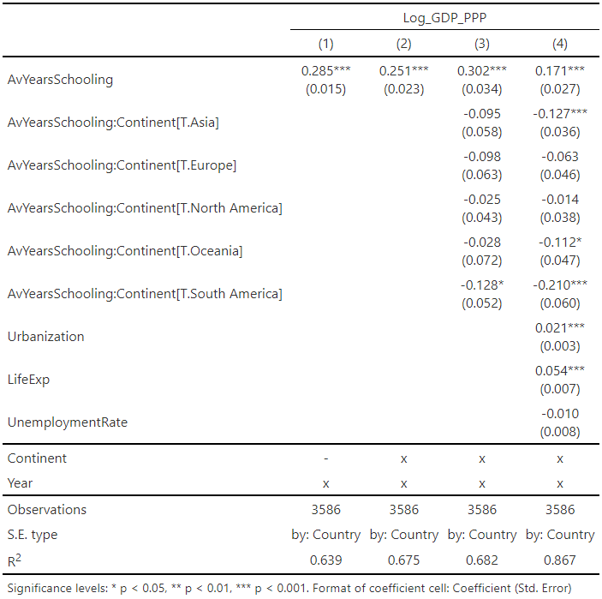
Regional Effects
Education drives growth, but regional disparities exist
South America, Asia and Oceania show weaker returns on education compared to Africa
Urbanization and life expectancy are significant contributors to GDP
Notes:
Talking Points
Interaction Terms:
account for regional differences
identify non-uniform effects (varying impact of education)
capturing more nuanced relationships
Africa as reference:
Low GDP
Trying to avoid multicollinearity -> unique economic characteristics
Interpretation
1. decrease from 0.285 to 0.251 when accounting for the regional disparities by adding continents as fixed effects
2. in the case of Africa the average years of schooling are positively associated with GDP, in comparison the effects of schooling on GDP are weaker for the other continent compared to Africa (negative values)
education is a driver of GDP, but returns vary significantly across regions -> further research focus on subgroups
3. 1% increase in urbanization associated with a 2.1% increase in GDP, likely tied to economic productivity and access to services
1 year increase in life expectancy associated with 5.4% increase in GDP, emphasizing the role of improved health
adding fixed effects, the interaction terms and additional controls progressively improves the explanatory power of the model
Transition
based on the findings when looking at continents we wanted to go one step further and look into a specific region

Slide 9
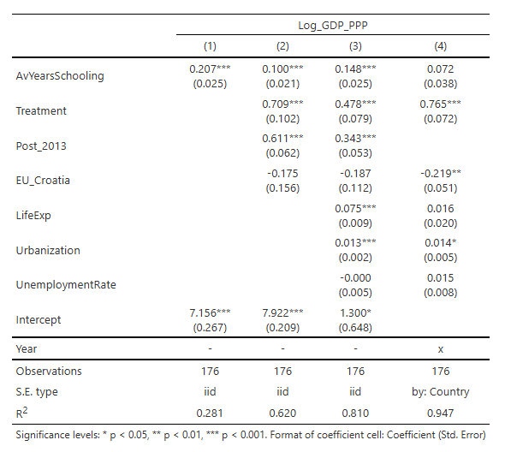
Difference-in-Difference Estimation
Baseline advantage for Croatia
Post-2013 growth for all countries
Negative effect of EU Membership (Model 4)

Slide 10
Causal Interpretation and Limitations
Challenges
Omitted Variable Bias
Quality of Institution
Historical Event
Reverse Causality
Higher GDP → Better Education = Feedback Loop
Multicollinearity
Strong correlations make coefficients unreliable
Solutions
Instrumental Variables
Historical policies
Machine Learning
Explore non-linear and heterogeneous effects
Dynamic Panel Models
Address feedback loop over time
Findings only show association, countries with higher schooling levels tend to have higher GDP
Notes:
Talking Points
Omitted Variable Bias from leaving out factors
use IV that are correlated with the omitted variable but not GDP
use ML to model complex relationships including proxy variables to capture effects of omitted factors
Reverse causality, GDP also influences schooling -> feedback loop
use IV to identify instruments that affect education but aren't influenced by GDP
use Dynamic Panel Models to incorporate lagged variables capturing temporal dynamics -> lagged GDP as predictor for current education levels and vice versa
Multicollinearity occurring when predictors are highly correlated
use ML to extract uncorrelated components from correlated variables -> Principal Component Analysis (PCA)
use Dynamic Panel Models to model temporal trends by focusing on within-entity variation
Conclusion
our findings only show association, countries with higher schooling levels tend to have a higher GDP

Slide 11
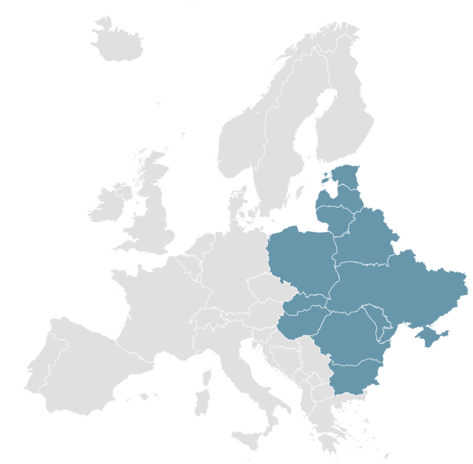
Further Research
Step 1: Collect Data on additional variables
Step 2: Focus on regional subgroup analysis
Dimensions | Variable | Description
Health and Demographics | Infant Mortality Rate | Proxy for healthcare
 | Population Age Structure (proportion of working-age population) | Reflect economic productivity potential
Politics | Political Stability | Fragile States Index
 | Ease of Doing Business | World Bank Index
 | Corruption Index | Measure of perceived corruption
Geospatial Data | Latitude | Proxy for climatic conditions
Notes:
Talking Points:
as we mentioned before introducing machine learning as well as adding instrumental variables could improve the research -> therefore start with collecting data on additional variables
furthermore put focus on the analysis of regional subgroups, as accounting for continental difference showed possible improvements when moving away from global approach
in the table we added dimensions and variables that could improve the research

Slide 12
THANK YOU FOR LISTENING! EEMP 2024 – GROUP 1
Angelika Stauch, Patrik Zoltan Peter, Oskar Matthias Lange

